Slide 1
Air Pollution in the Tristate Area: Trends & Health Effects
Project 1
Group Name: Still Breathing?
Group Members:
Zuhair Shahzad, Saniya Sule, Eric Meyer, Parag Patel, Bhavani Sathya

Slide 2
Project Overview
We examined the trends in outdoor air quality, based on established air quality indicators, from the U.S. Environmental Protection Agency (EPA). We also examined potential trends in the temporal associations between air pollutants and specific health effects in humans.
Key Questions:
What are the trends for Air Quality Indicators (AQIs) for the tristate area over the last 40 years?
What are the trends in the air quality-related health outcomes in the tristate area over the last 10 years?
Are specific air pollutant gases more closely associated with negative health outcomes than others in the tristate area?

Slide 3
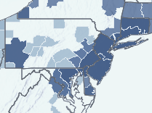
Background
Clean Air Act was passed in 1963, with amendments in 1970 and 1990.
Air pollution is associated with several health effects, particularly respiratory illness.
Air quality measurements for the tristate area (NY, NJ, CT) have not consistently met the U.S. EPA National Ambient Air Quality Standards (NAAQS).ª

Slide 4
Background
EPA AQI Categories^{b} | Description | Project Category
Good (0-50) | Air quality is satisfactory | Acceptable Air Quality
Moderate (51-100) | Air quality is acceptable | Acceptable Air Quality
Unhealthy for Sensitive Groups (101-150) | People with lung disease, older adults and children are at a greater risk from exposure to ozone, whereas persons with heart and lung disease, older adults and children are at greater risk from the presence of particles in the air. | Poor Air Quality
Unhealthy (151-200) | Everyone may begin to experience some adverse health effects, and members of the sensitive groups may experience more serious effects. | Poor Air Quality
Very Unhealthy (201-300) | Everyone may begin to experience some adverse health effects, and members of the sensitive groups may experience more serious effects. | Poor Air Quality
Hazardous (> 301) | This would trigger health warnings of emergency conditions. The entire population is more likely to be affected. | Poor Air Quality
U.S. Environmental Protection Agency tracks individual air pollutant concentrations as well as compiling an overall air quality index (AQI).
The AQI focuses on health effects that may be experienced within a few hours or days after breathing unhealthy air.

Slide 5
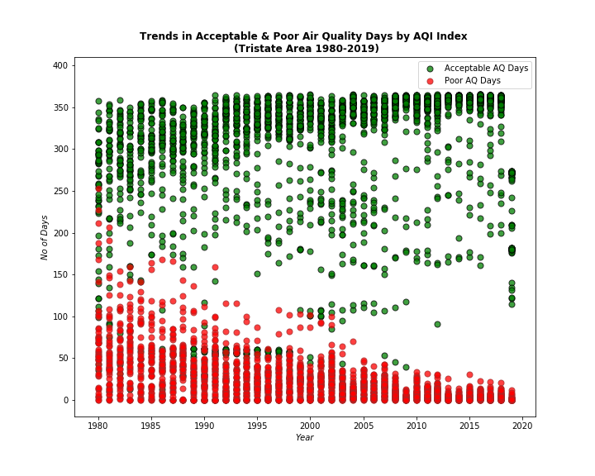
Forty-year Trend in AQI (1980 – 2019) Tristate Area (NY, NJ, CT)

Slide 6
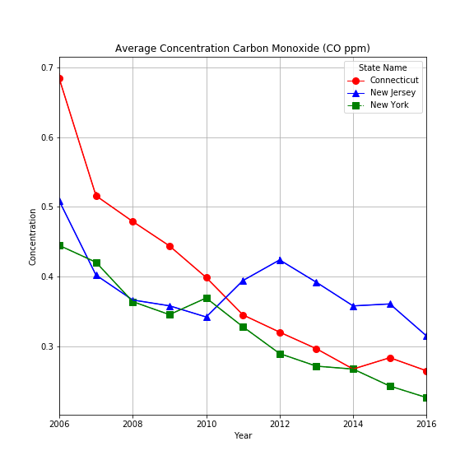
Trend: Carbon Monoxide (CO) Concentration (2006-2016) for the Tristate Area
All CO gas concentrations in ambient air over the 10-year period were well under the 35 parts-per-million (ppm) one-hour limit specified by the U.S. EPA.^{c}
New Jersey CO concentrations show a less consistent decrease during this period than NY and CT.

Slide 7
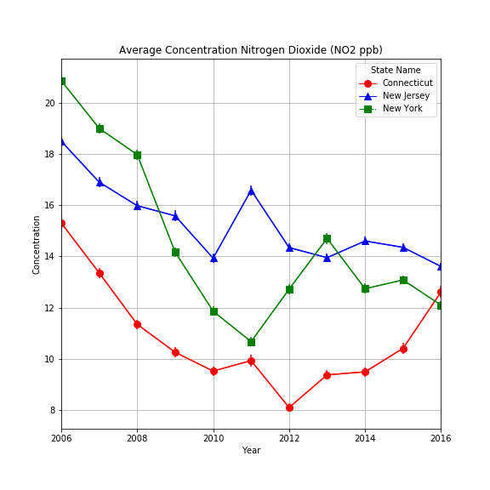
Trend: Nitrogen Dioxide (NO2) Concentration (2006-2016) for the Tristate Area
All NO2 gas concentrations in ambient air over the 10-year period were well under the 100 parts-per-billion (ppb) one-hour limit specified by the U.S. EPA.^{c}
New Jersey NO2 concentrations show a less consistent decrease during this period than NY and CT.
Remain on a decreasing trend beginning in 2014.

Slide 8
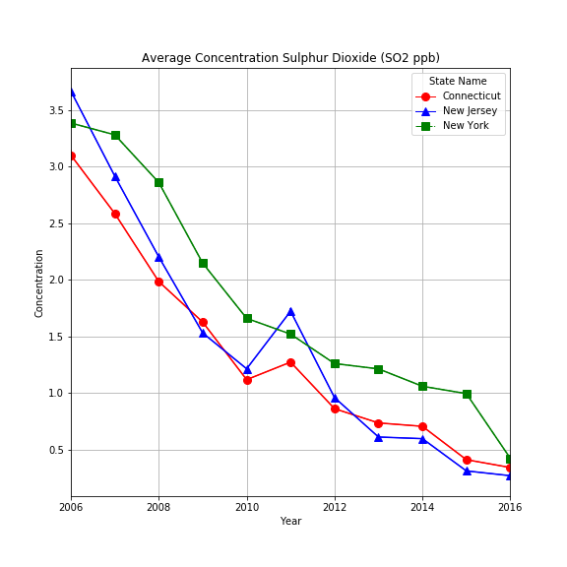
Trend: Sulphur Dioxide (SO2) Concentration (2006-2016) for the Tristate Area
All SO2 gas concentrations in ambient air over the 10-year period were well under the 75 parts-per-billion (ppb) one-hour limit specified by the U.S. EPA.^{c}
New Jersey SO2 concentrations show a less consistent decrease during this period than NY and CT.
NJ continues on a decreasing trend and average concentrations are less than NY and CT levels as per 2016 data.

Slide 9
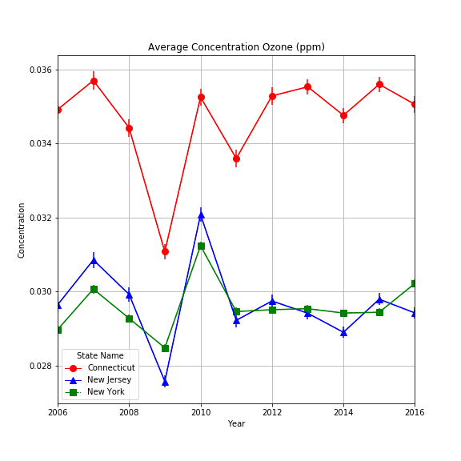
Trend: Ozone (O3) Concentration (2006-2016) for the Tristate Area
All O3 gas concentrations in ambient air over the 10-year period were under the 0.070 ppm eight-hour limit specified by the U.S. EPA.^{c}
New Jersey O3 concentrations show patterns consistent with that of NY and CT during this period.
NJ shows a decreasing trend beginning in 2015 and average concentrations are less than NY and CT levels as per 2016 data.
Ozone levels are more closely related to respiratory illness than other gas pollutants.
CT levels are consistently the highest and NJ may experience some effects due to proximity and movement of air currents.

Slide 10
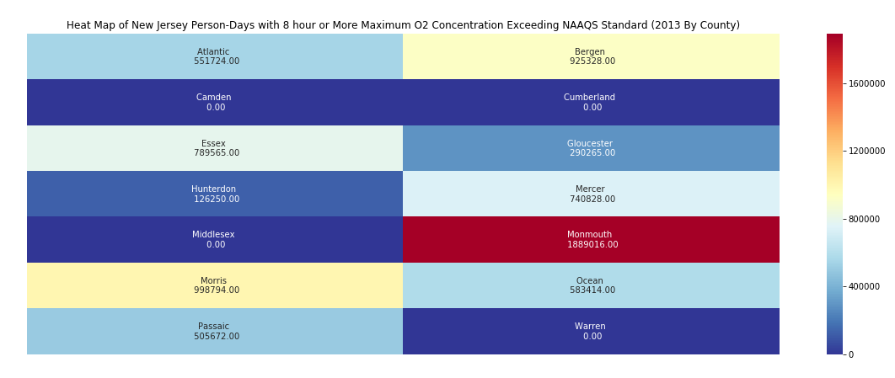
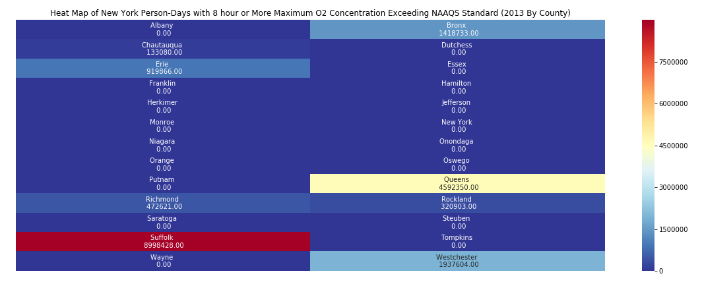
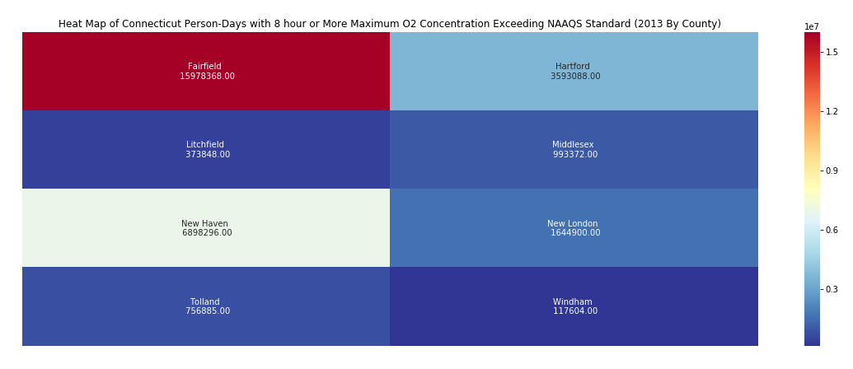
Heat Maps: 2013 Ozone Levels

Slide 11
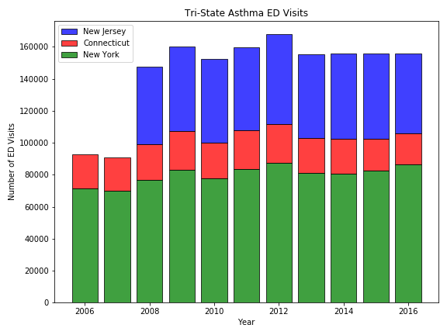
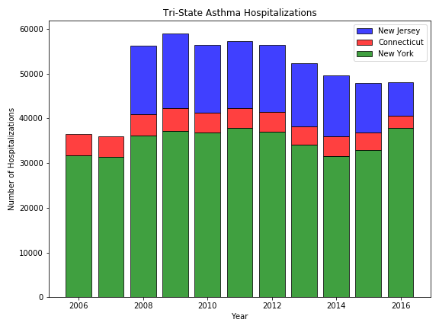
Asthma Emergency Department Visits & Hospitalizations for the Tristate Area (2006-2016)

Slide 12
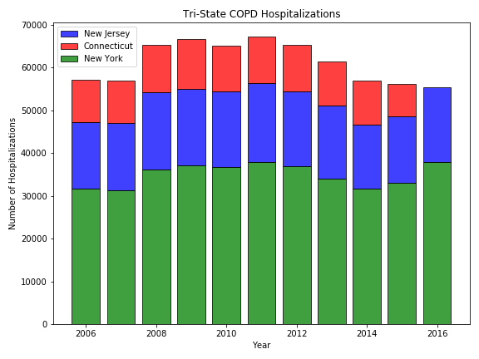

Hospitalizations for Chronic Obstructive Pulmonary Disease (COPD) in the Tristate Area (2006-2016)

Slide 13
Conclusions
Overall
Air quality in the tristate area has improved since 1980 and over our assessment period (2006 – 2016)
Forty-year data shows consistent increases in the number of Acceptable AQ days and a corresponding decrease in Poor AQ days.
Individual Air Pollutants (average concentration)
2006 to 2009 – consistent decrease
2010 to 2013 – some increases noted
2013 to 2016 – mostly decreasing trend for CO, SO2; some increases noted for NO2, O3
Hospitalizations (Asthma & COPD) & ED visits (Asthma)
Asthma: Increases noted beginning in 2008 with ED visits remaining steady afterwards and a decreasing trend in asthma-related admissions
COPD hospitalizations: Increase noted 2008 – 2011; subsequent decrease until 2015.
Start of increasing trend noted in 2016, which coincides with increase in ozone concentrations.

Slide 14
Questions?

Slide 15
Methods
EPA AQI Data
EPA Individual air pollutant data (gases)
Limitations: Used data available
Note: all years and/or locations not available for all datasets
Utilized zip_download function to download the large datasets for data more than a decade
Utilized API and Seaborn to create heat maps for ozone levels in tristate by county

